Slide 1
neoclassical.ai
Molecular Assemblies
Notes:
Hi. Welcome to this episode of Emergent Nature.
My name is J Mark Morris. I go by Mark.
In this episode I’ll discuss the error that caused science to go off track into general relativity and quantum mechanics.
That may seem like an unusual thing to say, since general relativity and quantum theory are generally considered to be successful effective theories.
However, as we will see, an error circa 1900 threw science off track.
There is a parsimonious solution to nature.

Slide 2
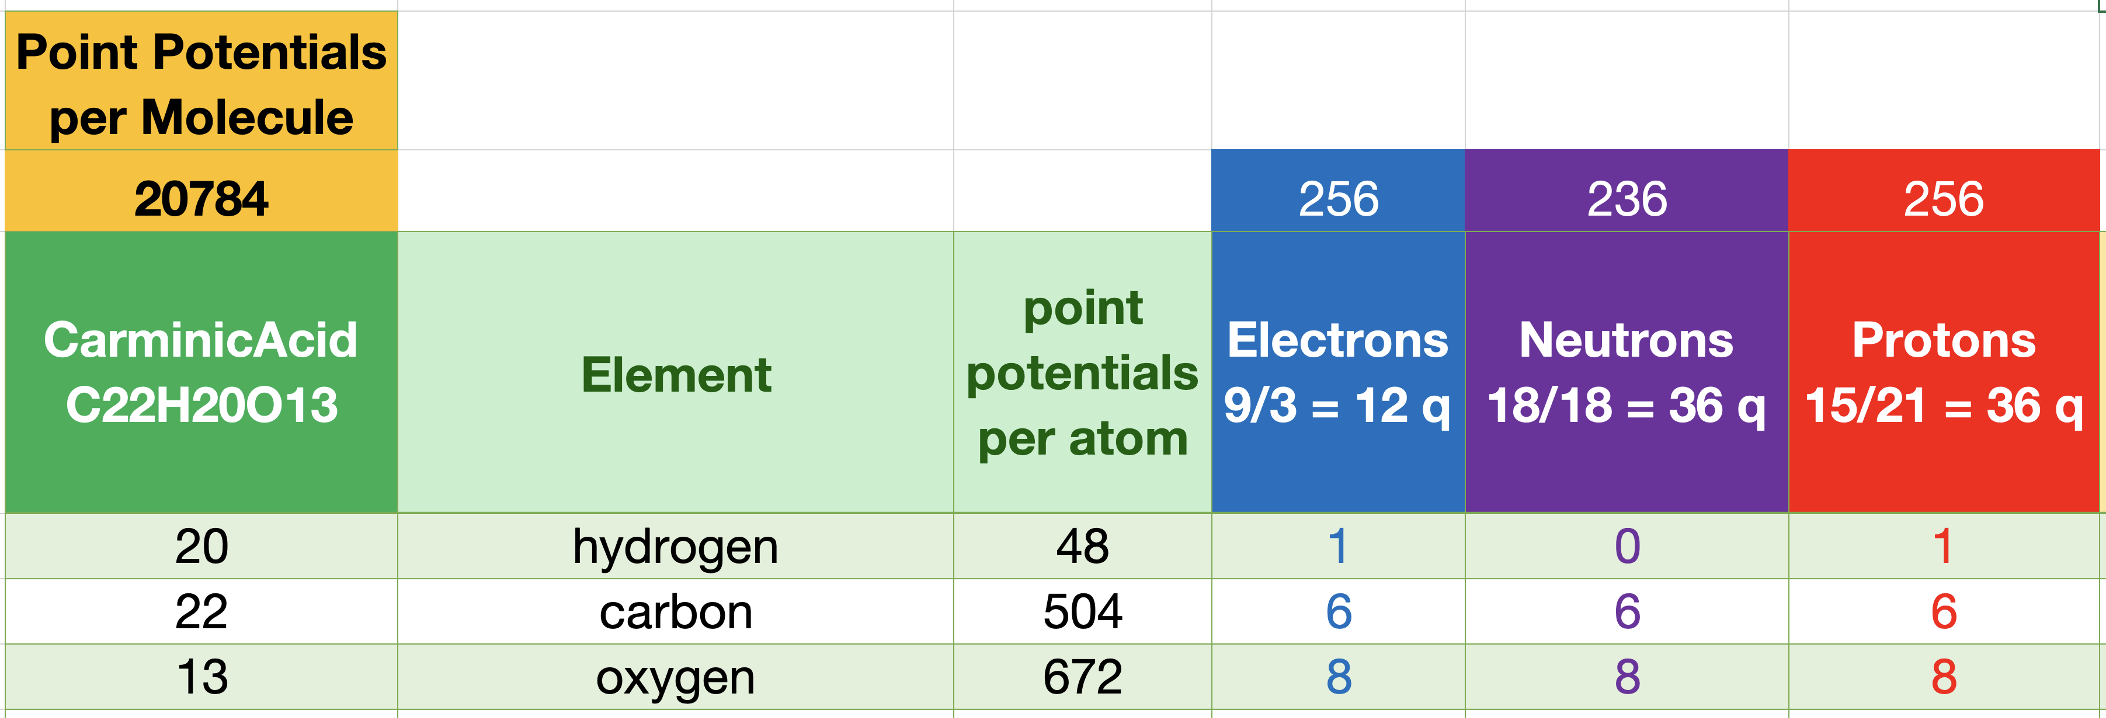
Carminic Acid C₂₂H₂₀O₁₃ is an assembly of 20784 Point Potentials
Carminic acid (C₂₂H₂₀O₁₃) is a red glucosidal hydroxyanthrapurin that occurs naturally in some scale insects, such as the cochineals.
The insects produce the acid as a deterrent to predators.
An aluminum salt of carminic acid is the coloring agent in carmine, a pigment.
Natives of Peru produced cochineal dyes for textiles since at least 700 CE.
Carminic acid has a core anthraquinone structure linked to a glucose sugar unit.
J Mark Morris

